Slide 1
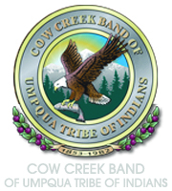

GRADE 7
Seasonal Calendar

Slide 2
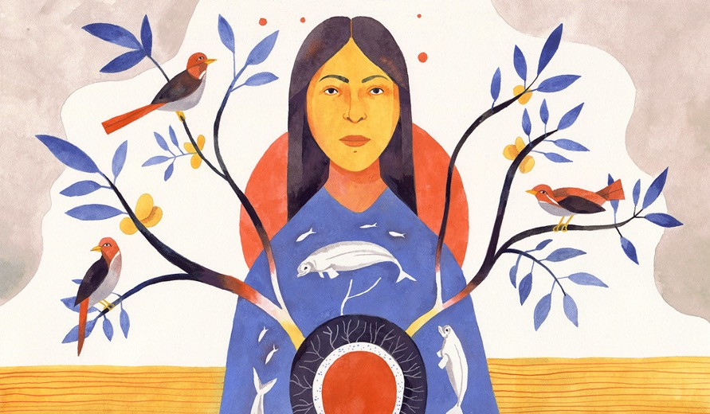

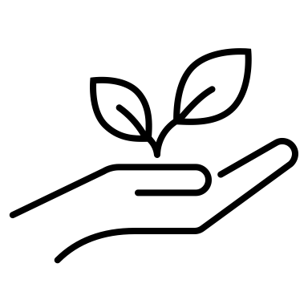

Traditional ecological knowledge (TEK)
Traditional
  Long established
Ecological
  Interrelationship of living organisms and their surroundings
Knowledge
  Theoretical or practical understanding of a subject
Image from Yale Environment 360 https://e360.yale.edu/features/native-knowledge-what-ecologists-are-learning-from-indigenous-people
Notes:
Say:
The best way to understand traditional ecological knowledge, or TEK, is to break it down by its individual terms: Traditional means a long-established way of doing something. It’s something that has become part of a culture—a tradition. Ecological refers to the interrelationship of living organisms and their surroundings. Knowledge is the theoretical or practical understanding of a subject. Traditional ecological knowledge, then, is a long-established practice of relating to and taking care of the land, plants, and animals. It is the specific knowledge about how to do that, and it is the act of putting that knowledge into practice. An example of TEK is knowing when to plant seeds in specific area so that they thrive and produce food several months later. What might be another example of TEK? What might be other images that come to mind as we define TEK?

Slide 3
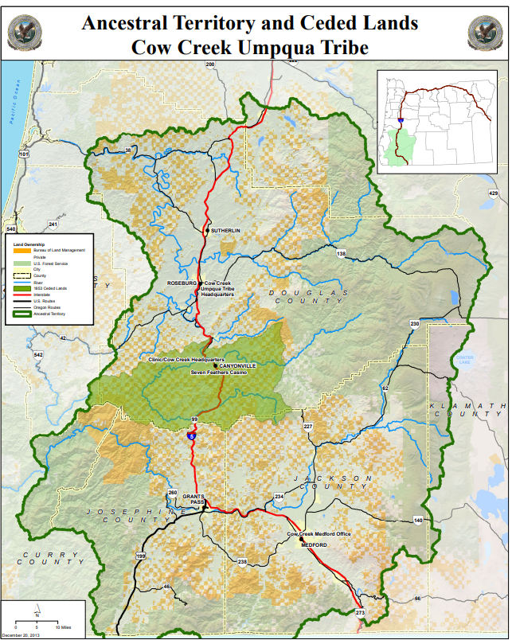
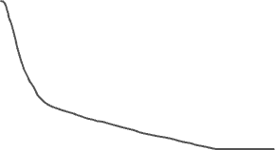
Map
Mountain Region
Mountain Region
Lowlands
Notes:
Say:
This map shows the original lands inhabited by the Cow Creek Band long before contact with other settlers. As you can see, they lived in a vast area of Oregon—6.3 million acres in total. The Tribe knew this land and the natural cycles of the environment extremely well. Their traditional ecological knowledge of this territory had been developed over thousands of years of living here.
Say:
The Tribe traveled often, following seasonal changes. Traditionally, they would travel as far as 60 miles within their traditional homelands. In spring and summer, they traveled into the mountains to fish, hunt, forage, and preserve food for the winter months. In winter, they descended into the lowlands where they maintained permanent villages. Their hunting and gathering practices followed a seasonal calendar, meaning they were careful to harvest ingredients when they were at their most abundant. It also meant they planned well in advance for periods in which resources were scarce. The practice of living in connection with the land—its seasons, rhythms, and resources—and the knowledge about how to do that are what we refer to as traditional ecological knowledge. This knowledge and practice were the heart of Cow Creek culture and remain so to this day. The people are inseparable from the land.
Say:
The Cow Creek Band’s traditional ecological knowledge reminds us that ecology is not a new science. Tribal societies like the Cow Creek Band of Umpqua Tribe of Indians have been in this region since time immemorial. This means that they have lived here for thousands of years—long before anyone can remember. Their understanding of the ecology of the environment was, is, and continues to be central to their ways of being. Contemporary scientists are only beginning to understand and appreciate the depth and breadth of this knowledge.

Slide 4
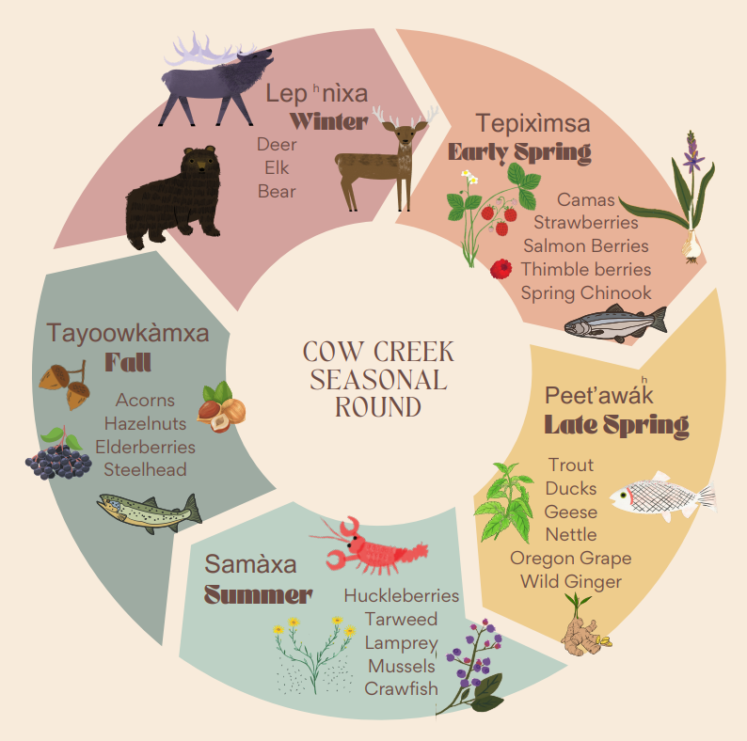
Notes:
Say:
Let’s connect the information from the reading to the Cow Creek Seasonal Round presented here. This infographic shows the plants and animals harvested by the Cow Creek people during each season. Compare this to the reading. How does the information presented here confirm or support what you read? Does the graphic present any information that wasn’t in the reading? Did anything surprise you?

Slide 5
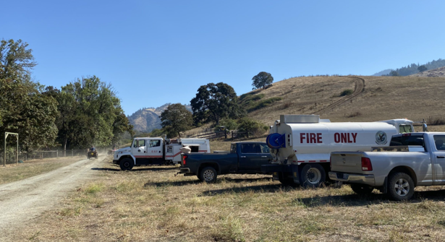
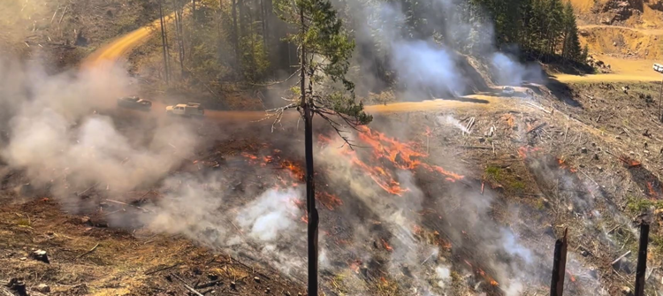
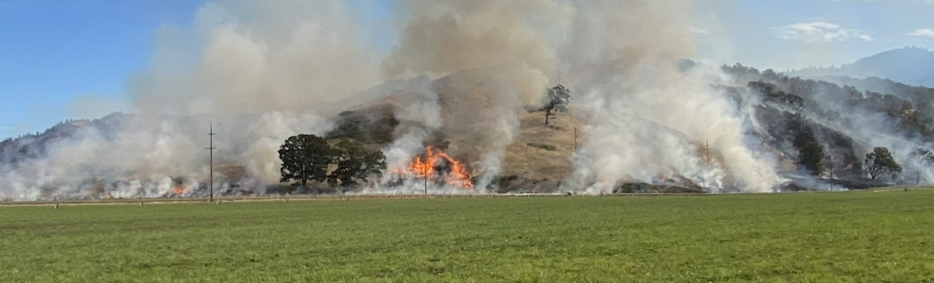
Prescribed burn
https://www.cowcreek-nsn.gov/video-successful-prescribed-burn-on-cow-creek-forest-lands/
https://www.cowcreek-nsn.gov/photos-tribe-conducts-prescribed-burns-near-myrtle-creek/
Notes:
Say:
The Cow Creek Band practiced land management techniques that sustained a strong and healthy interdependence among people, plants, and animals. One of these practices is a prescribed burn, which is a controlled application of fire in a specific area. Prescribed burns maintained the health of the forest by diminishing harmful bugs and removing undergrowth that blocked plants’ water access. The burns cleared forest pathways for deer and elk to graze easily within the sight of hunters, who harvested the meat during fall and winter.

Slide 6
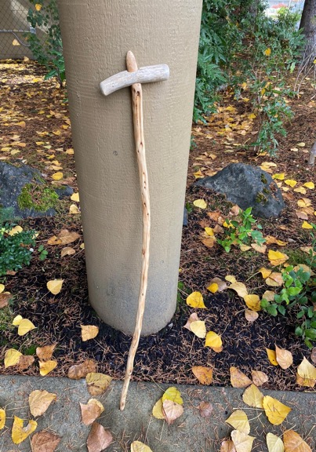
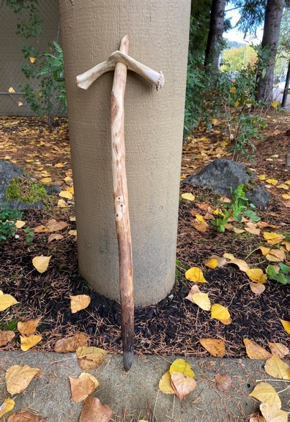
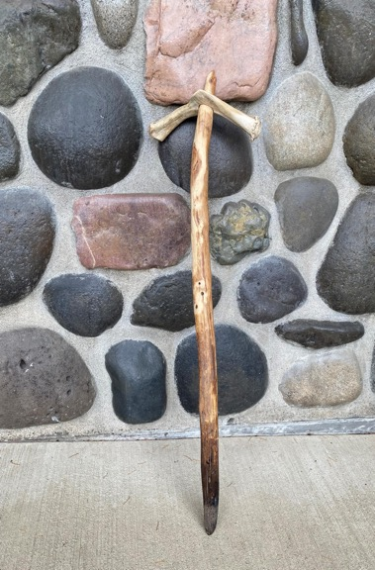
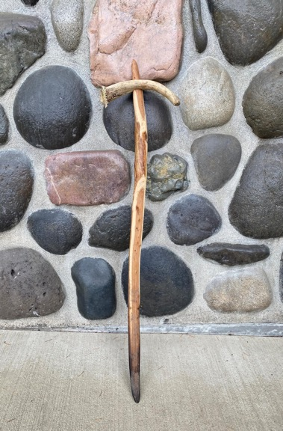
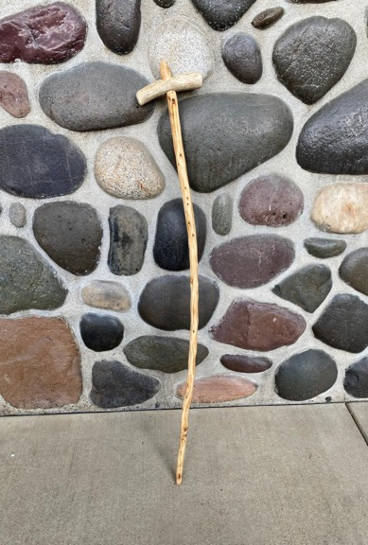
Digging sticks
Notes:
Say:
These are examples of digging sticks from the Tribe. Notice the design and structure of the stick and imagine how it might be used then and now. During the spring and fall, Cow Creek women and children used these tools, which are made from yew or spruce wood, to weed unwanted plants and aerate the soil of the lowland riverbanks in preparation for planting. The healthy plants grown there provided much-needed bank security and foliage for water species. Digging sticks were also used to harvest shellfish such as littleneck clams, butter clams, horse clams, geoduck, and mussels.

Slide 7
Consider the Cow Creek Band of Umpqua Tribe of Indians’ relationship to the land
What do you think the ecology of the region looked like 200 years ago compared to how it is today?
What might be different?
What might be the same?
How do these practices reflect what we know about traditional
ecological knowledge?
Notes:
Say:
Now, I want you to turn to the person next to you and discuss the question on the slide: Consider the Cow Creek Band of Umpqua Tribe of Indians’ relationship to the land. What do you think the ecology of the region looked like 200 years ago compared to how it is today? What might be different? What might be the same? How do their practices reflect what we now know about traditional ecological knowledge?

Slide 8
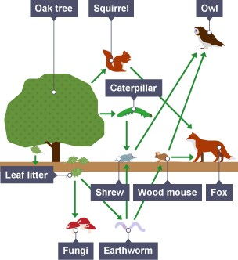
Relationship to land, plants, animals, and people
Notes:
Say:
In elementary school you will recall the idea of a food chain—that plants get their energy from the sun, small animals eat plants, and big animals eat small animals and sometimes plants, too. You have also learned, in early grades, that it’s not a chain, where an animal only eats one thing, but rather a web, and that an animal has a greater chance of surviving if it has a variety of food sources. As we learn more, we see the interconnectedness not just of the plants and animals, but the entire environment. As we look at this simple food web, we can see that the earthworm provides nourishment directly to two animals, but also indirectly to all the animals in this graphic. And this graphic doesn’t even show all the connections. For example, when earthworms and animals die, they put nutrients into the soil, which the oak tree needs to survive. What are some other connections between these plants and animals that are missing from this particular graphic?

Slide 9
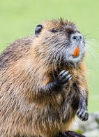
Can beavers save salmon in Oregon’s high desert?
Group 1 What does the beaver population need in their healthy environment? | Group 2 How does the beaver population impact its environment?
Group 3 How do other animals benefit from the beaver population? | Group 4 How does the beaver population negatively impact the environment?
Everyone: How might the practice of prescribed burning impact the beaver population and others?
Notes:
Say:
Before you watch the video, I’m going to divide you into groups of four to focus on a single question as you watch. After watching I’ll mix you up so that there is at least one person in each group with a different focus. I encourage you to take notes so that you can contribute fully to the discussions. Continue to use cause-and-effect statements.

Slide 10
Team research
Environmental needs including habitat and food sources include at least two Takelma words
Four things that can impact (harm and/or help) the animal
Use cause and effect sentences
One must include how cultural burning affects the environment for the animal
A simple food web with at least 10 interconnected elements
Animal choices
Catfish
Coyote
Deer
Lamprey
Porcupine
Turtle
Woodpecker
Notes:
Say:
Taking the example of the beaver, you and a partner or a small group will choose one animal and create a presentation describing some ecological knowledge and the impacts of the animal on the environment. Your presentation can be a poster, a written paper, or a slide deck. It must include the elements you see on the right side of this slide. As a team you need to stay organized and determine things together. You only have this class period to research and complete the task. I encourage you to use the Takelma Language Dictionary at https://www.cowcreekeducation.com/dictionary/

Slide 11
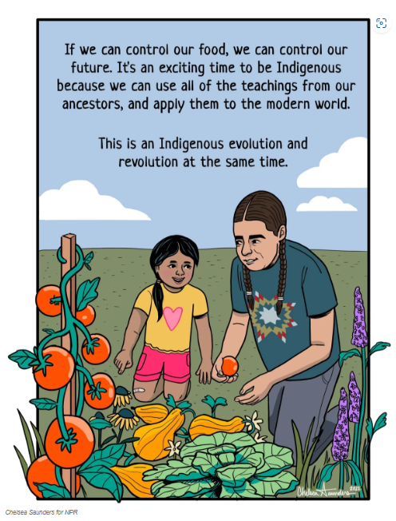
Food sovereignty
People’s right to healthy and culturally appropriate food produced through ecologically sound and sustainable methods, and the right to define their own food and agriculture systems.
For a time Cow Creek Tribal members were not allowed to engage in traditional practices of hunting and harvesting.
The U.S. government provided food rations, which were often unhealthy and insufficient.
Notes:
Say:
Sovereignty means the right to govern and self-rule. The Cow Creek Band has its own Tribal government that has the right to make and carry out laws. It is a Tribal nation, with sovereignty that is separate from the U.S. government, Oregon state government, and local governments. When the word sovereignty is connected with food, it means “The right to healthy and culturally appropriate food produced through ecologically sound and sustainable methods, and [a Tribe’s] right to define their own food and agriculture systems.” It’s important because many U.S. federal policies impacted the ability of the Cow Creek Band to make decisions for themselves, including their ability to follow their traditional seasonal rounds to harvest food and medicine. Many Tribes were forbidden to follow these rounds and instead were forced to eat food rations provided by the U.S. government. Not only did this make them dependent upon the U.S. government—which they did not want to be—the food was also very low quality and lacked nutritional value. In some cases, the food rations promised to Tribes were taken instead by U.S. soldiers or simply never delivered. Although these food rations—called “commodity boxes”—have improved, many are still low quality and highly processed, and many Indigenous people still rely on them. This has led to severe health problems for many Native people.
Many Tribes and individual Native people have focused on improving food sovereignty. One such advocate is the Lakota chef Sean Sherman. He has won many international awards and is one of several Native chefs that has advocated for incorporating traditional foods into our modern diets and for the importance of knowing where our food comes from, how it was raised and harvested, and how it is prepared.

Slide 12
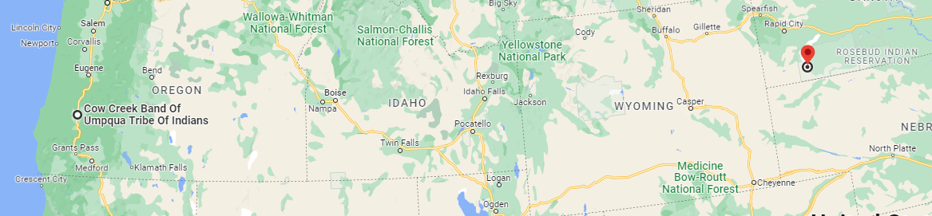
Comparing local natural resources
Image from Google Directions
Notes:
Say:
While Chef Sherman focuses on the resources in the Midwest, the climate and landscape in Southwest Oregon provide different resources. Here, we have milder winters and access to many rivers and lakes and to the Pacific Ocean. Turn to a partner (or triad) to discuss some resources we have access to that might not be available in the Midwest.

Slide 13
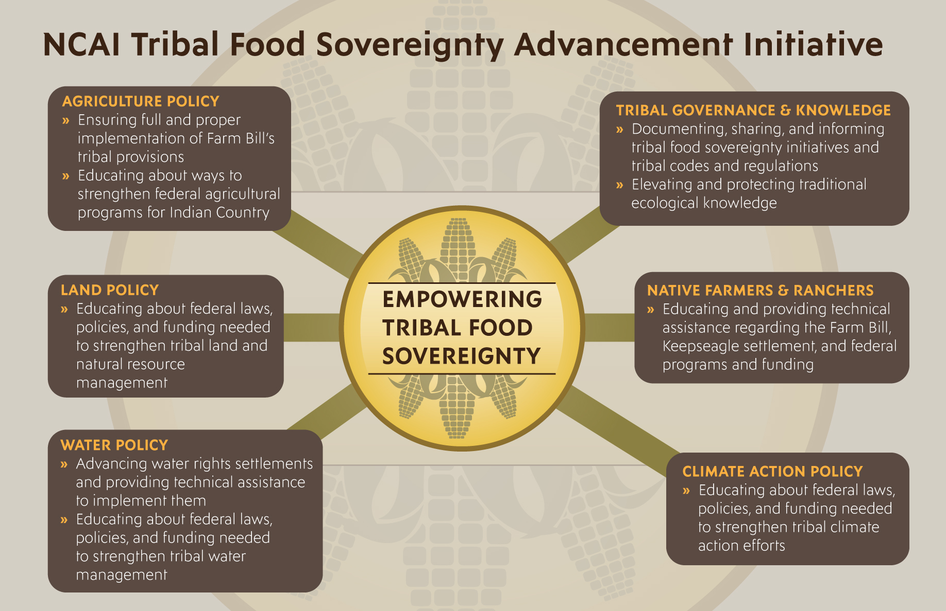
From: https://www.ncai.org/initiatives/partnerships-initiatives/food-sovereignty
Notes:
Say:
The National Congress of American Indians, or NCAI, is an organization that connections multiple Tribal nations on policy and resources. One of the big issues they are working on is food sovereignty. According to their website they “empower food sovereignty by creating a forum for tribal leaders to share best practices for advancing food sovereignty; assisting tribal governments with developing food sovereignty and related policies; advocating for federal policy changes needed to improve the quality and accessibility of food assistance and cultivation programs; protecting and sustaining tribal lands, waters, and natural resources integral to tribal food systems; and providing materials to help build the knowledge base and skills of current and aspiring Native farmers, ranchers, and other food providers.” In this infographic NCAI identifies six primary work components.

