Slide 1
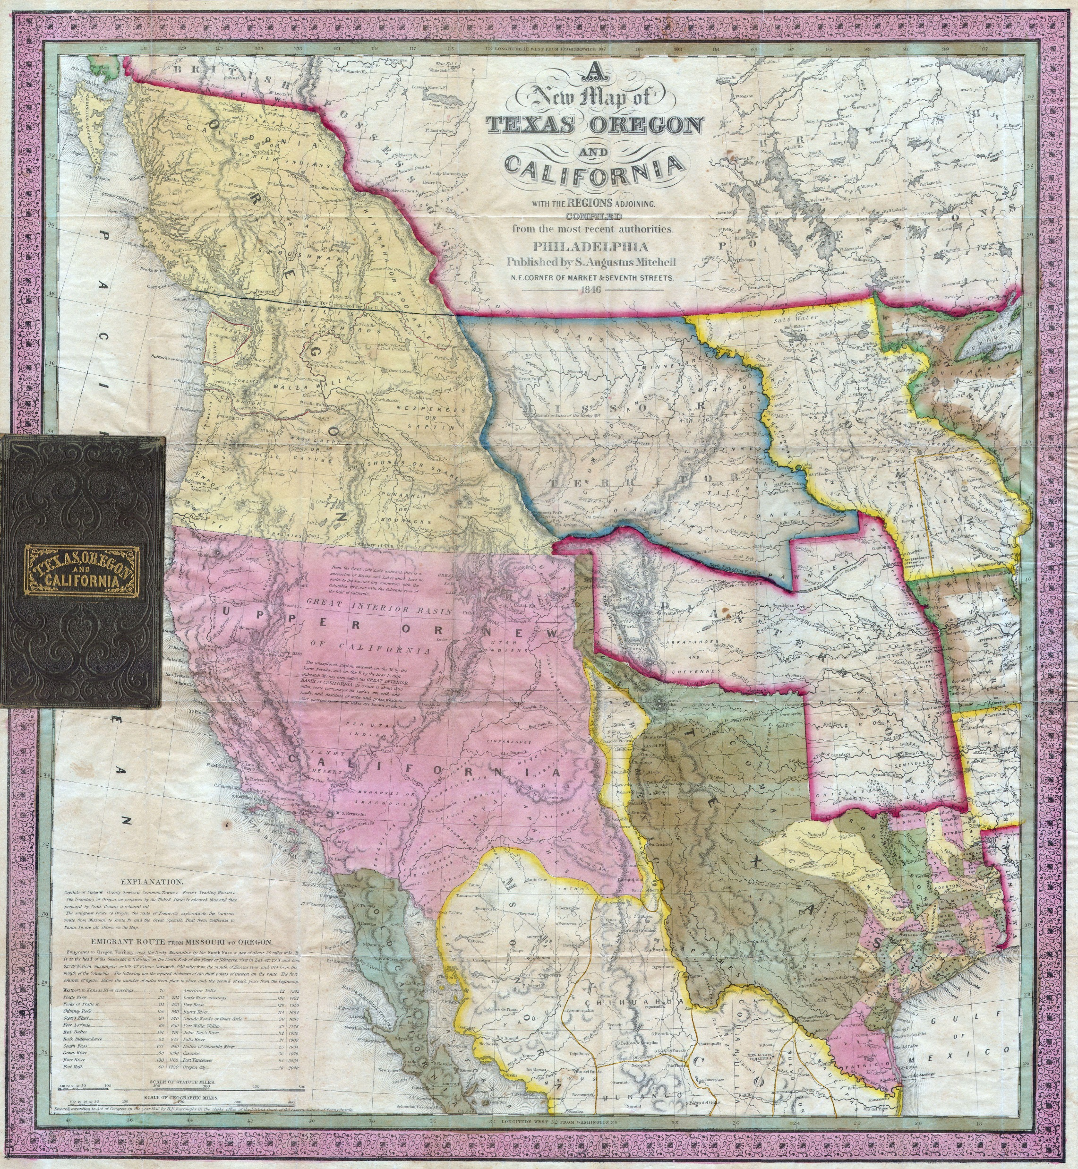
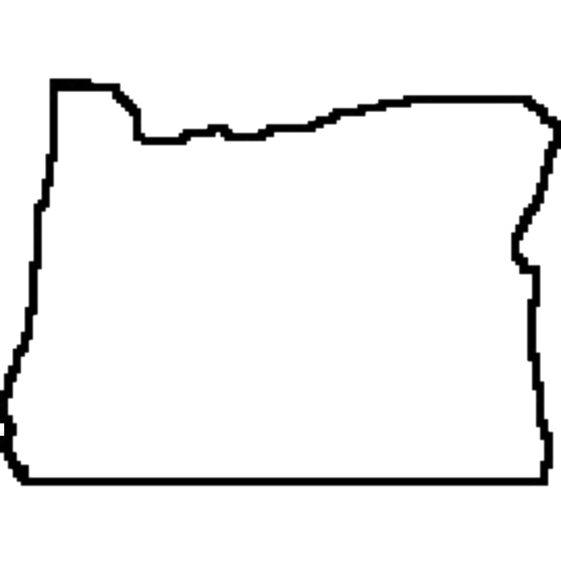
This map is from 1846 and shows the region that was then known as Oregon Territory. Later that year, the United States and Britain decided to split this territory at the line between present-day Canada and Washington state. The modern outline of the state of Oregon has been added in black on top of the original map to make it easier to find, but the state did not take this shape until it attained statehood in 1859.

Slide 2
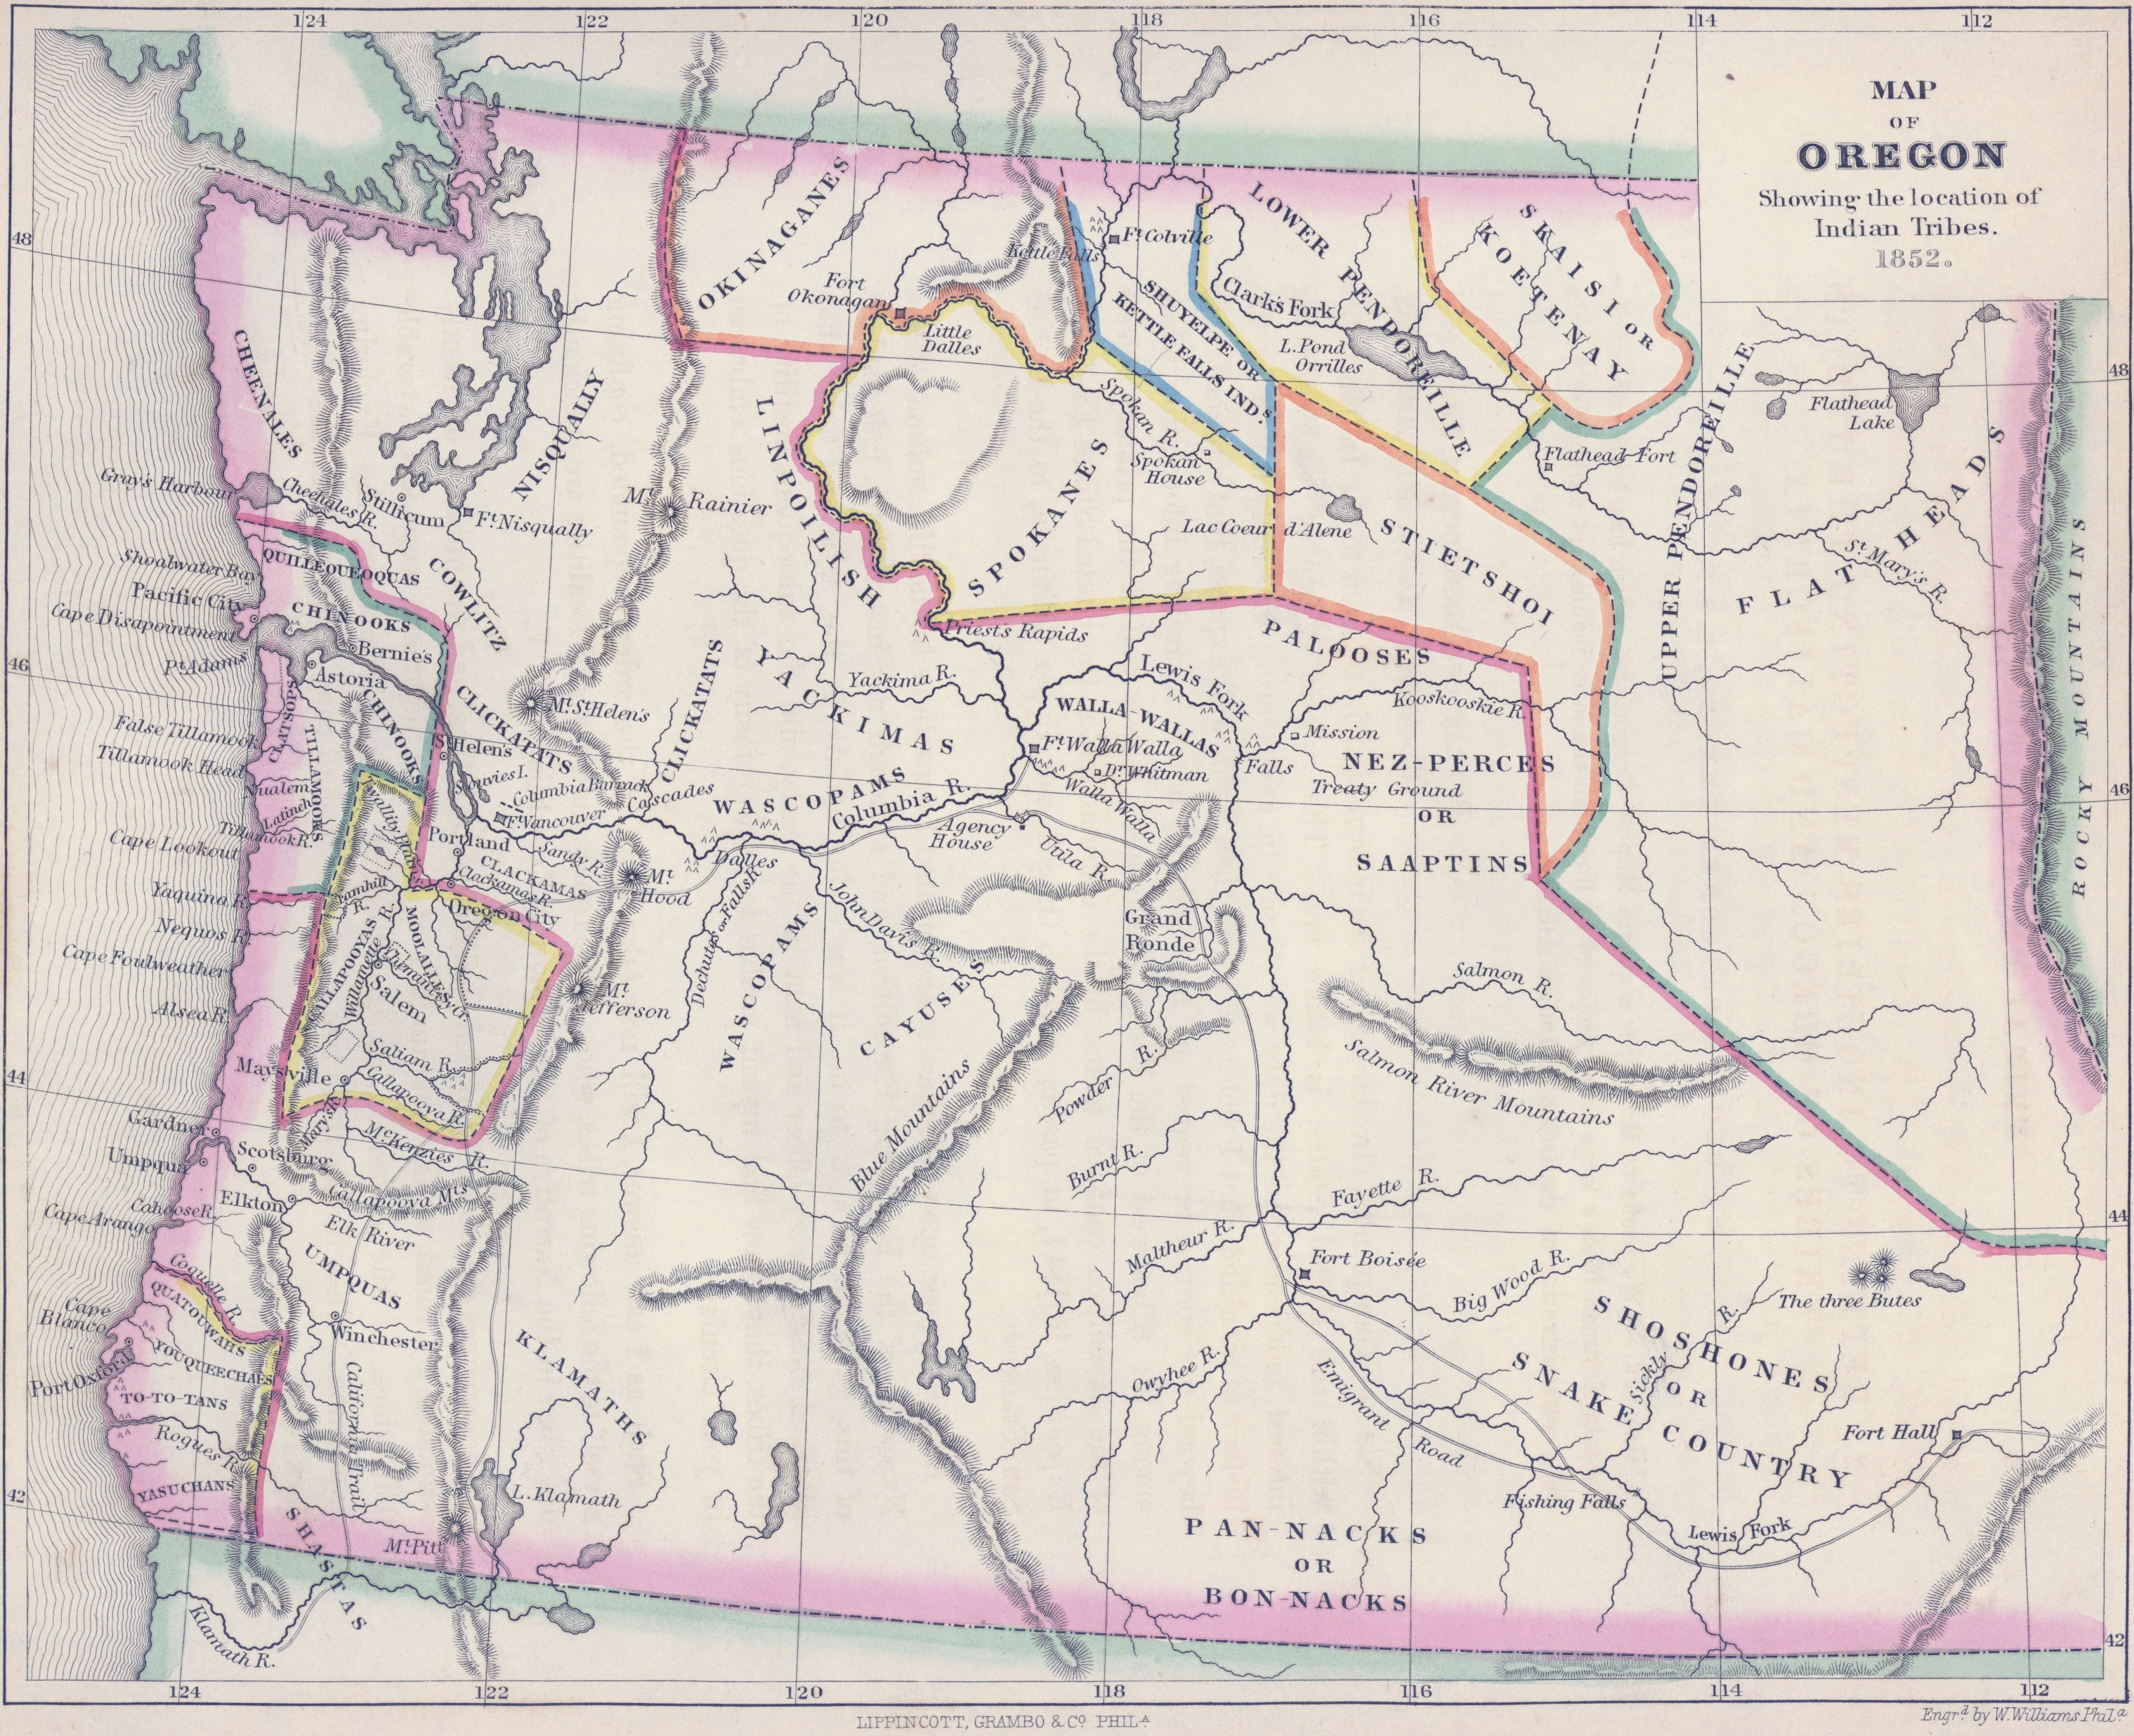
This map is from 1852 and shows the region before any treaties were made with Native Americans in what is now known as Oregon. The modern outline of the state of Oregon has been added in black on top of the original map to make it easier to find, but the state did not take this shape until it attained statehood in 1859.

